Slide 1

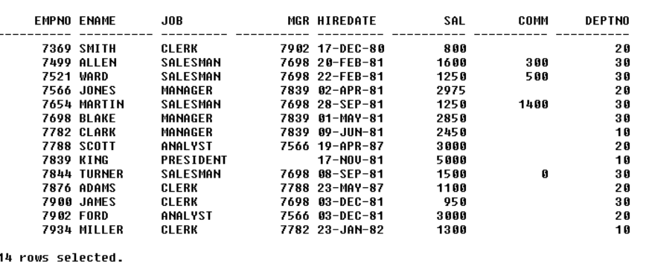
EMPLOYEE TABLE
INPUT:
OUT PUT:

Slide 2
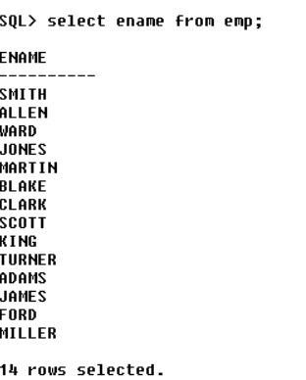
INPUT :
2.WAQTD NAMES OF ALL THE EMPLOYEES
OUT PUT:

Slide 3
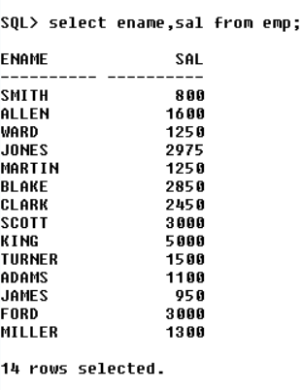
INPUT :
3.WAQTD NAME AND SALARY GIVEN TO ALL THE EMPLOYEES
OUT PUT:

Slide 4
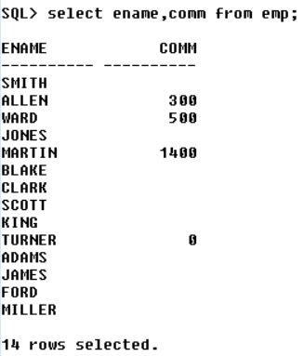
INPUT :
4.WAQTD NAME AND COMMISSION GIVEN TO ALL THE EMPLOYEES
OUT PUT:

Slide 5
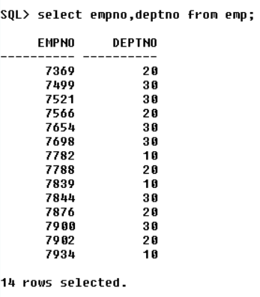
INPUT :
5.WAQTD EMPLOYEE ID AND DEPARTMENT NO. OF ALL THE EMPLOYEES
OUT PUT:

Slide 6
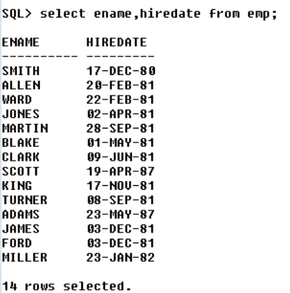
INPUT :
6.WAQTD ENAME AND HIREDATE OF ALL THE EMPLOYEES.
OUT PUT:

Slide 7
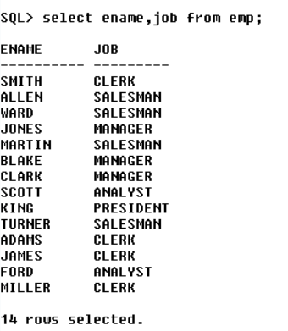
INPUT :
7.WAQTD ENAME AND DESIGATION OF ALL THE EMPLOYEES.
OUT PUT:

Slide 8
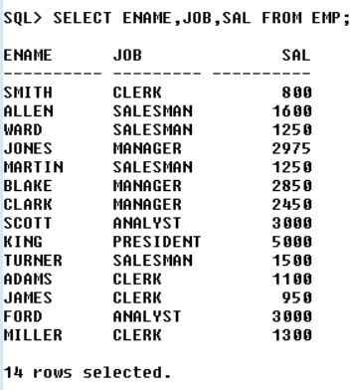
INPUT :
8.WAQTD ENAME ,JOB AND SALARY GIVEN ALL THE EMPLOYEES.
OUT PUT:

Slide 9
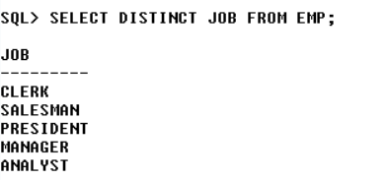
INPUT :
9.WAQTD DNAMES,PRESENT JOB IN DEPERTMENT TABLE.
OUT PUT

Slide 10
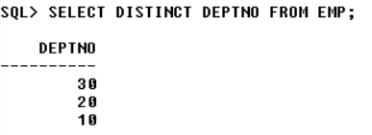
INPUT :
10.WAQTD DNAMES,AND LOCATION PRESENT IN DEPERTMENT TABLE.
OUT PUT:

Slide 11
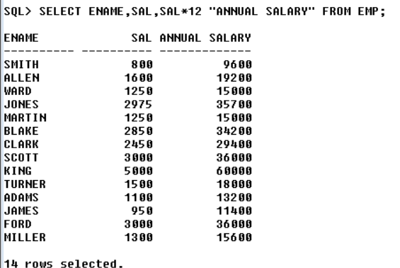
INPUT :( EXPRESSION & ALIAS):
1.WAQTD NAME OF THE EMPLOYEE ALONG WITH THEIR ANNUAL SALARY.
OUT PUT:

Slide 12
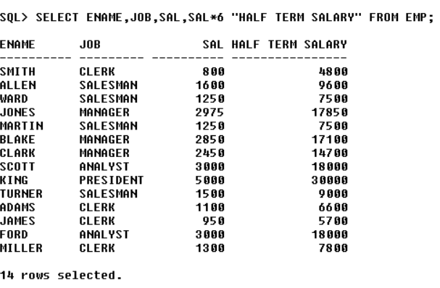
INPUT :( EXPRESSION & ALIAS):
2.WAQTD ENAME AND JOB FOR ALL THE EMPLOYEE WITH THEIR HALF TERM SALARY.
OUT PUT:

Slide 13
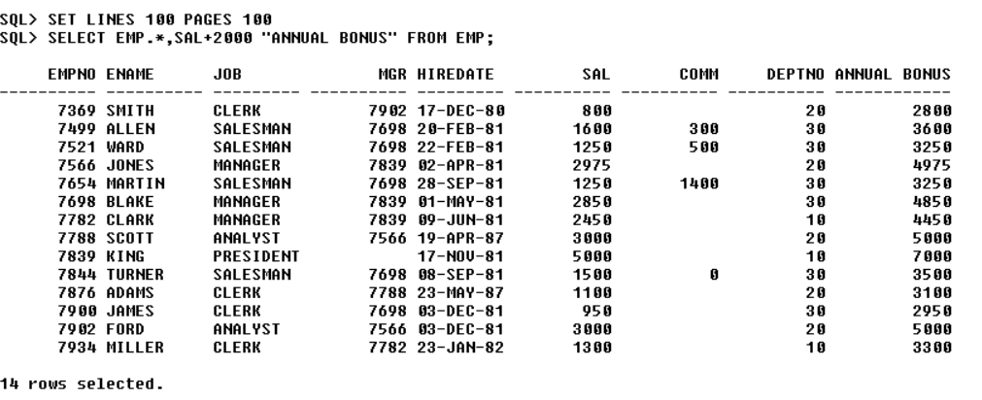
INPUT :( EXPRESSION & ALIAS):
3.WAQTD ALL THE DETAILS OF THE EMPLOYEES ALONG WITH AN ANNUAL BONUS OF 2000.
OUT PUT:

Slide 14
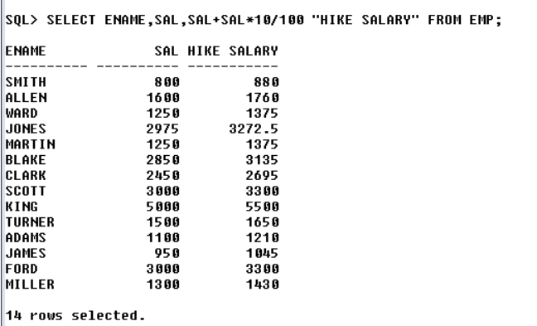
INPUT :( EXPRESSION & ALIAS):
4.WAQTD NAME SALARY AND SALARY WITH A HIKE OF 10%.
OUT PUT:

Slide 15
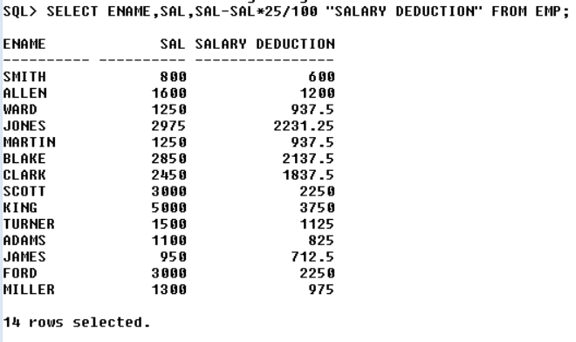
INPUT :( EXPRESSION & ALIAS):
5.WAQTD NAME AND SALARY WITH DEDUCTION OF 25%.
OUT PUT:

Slide 16
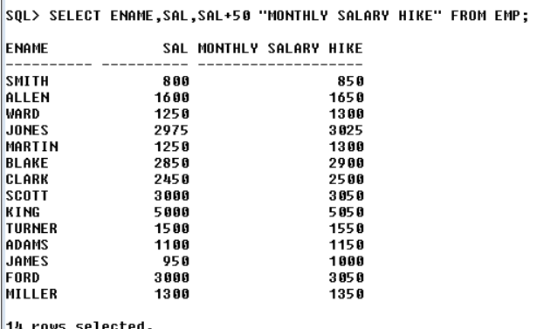
INPUT :( EXPRESSION & ALIAS):
6.WAQTD NAME AND SALARY WITH MONTHLY HIKE OF 50.
OUT PUT:

Slide 17
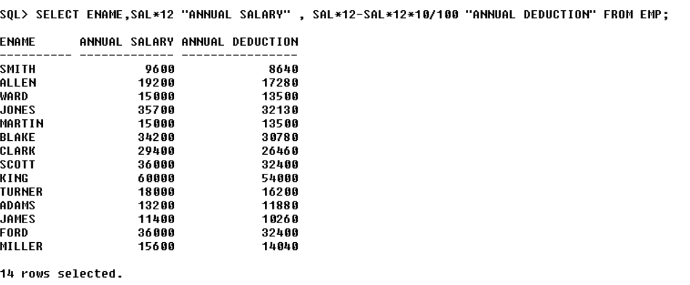
INPUT :( EXPRESSION & ALIAS):
7.WAQTD NAME AND ANNUAL SALARY WITH DEDUCTION OF 10%.
OUT PUT:

Slide 18
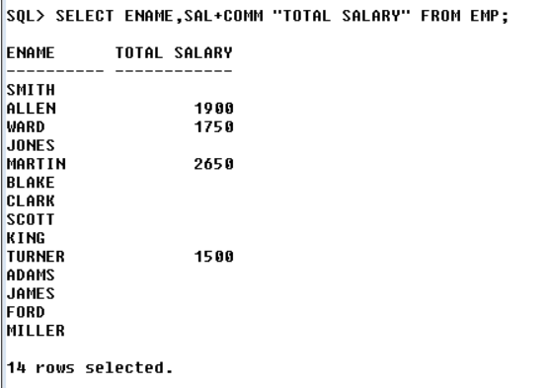
INPUT :( EXPRESSION & ALIAS):
8.WAQTD TOTAL SALARY GIVEN TO EACH EMPLOYEE (SAL+COMM).
OUT PUT:

Slide 19
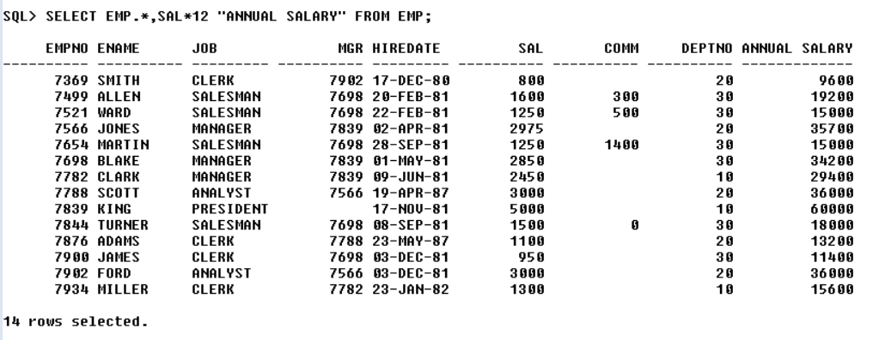
INPUT :( EXPRESSION & ALIAS):
9.WAQTD DETAILS OF ALL EMPLOYEES ALONG WITH ANNUAL SALARY.
OUT PUT:

Slide 20
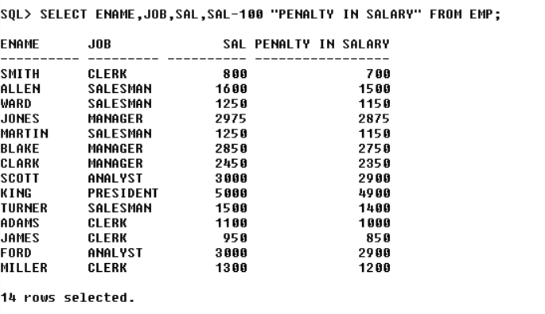
INPUT :( EXPRESSION & ALIAS):
10.WAQTD NAME AND DESIGNATION ALONG WITH 100 PENALTY IN SALARY.
OUT PUT:

